Slide 1
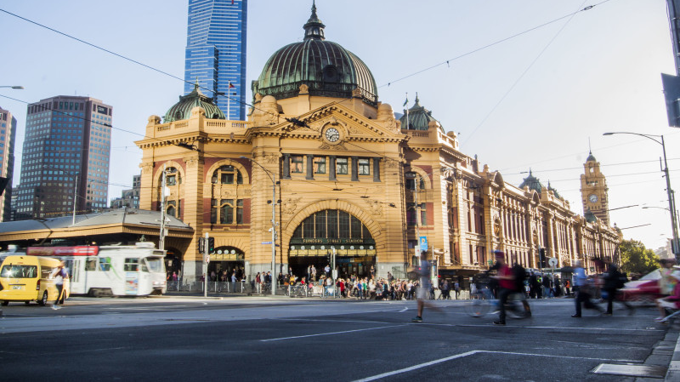
Melbourne Traffic Accidents Analysis 2014-2017 Presented by Yuchen

Slide 2

Content
1. Data Overview ………………………………………………………………………… 3
2. Common Accidents ………………………………………………………………… 6
3. Serious and Fatal Accidents …………………………………………………… 9
3. Other Recommendations and Limitations ……………………………… 14

Slide 3


Data Overview
Melbourne, 2014-2017
54,248 records
Land Grid Array, Streets, Date, Time, Accident Type, Definitions for Classifying Accidents, Road Geometry, Severity, etc.

Slide 4
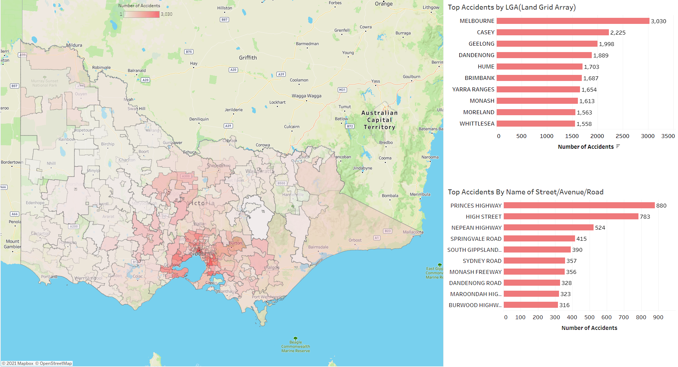
Melbourne Heat Map

Slide 5
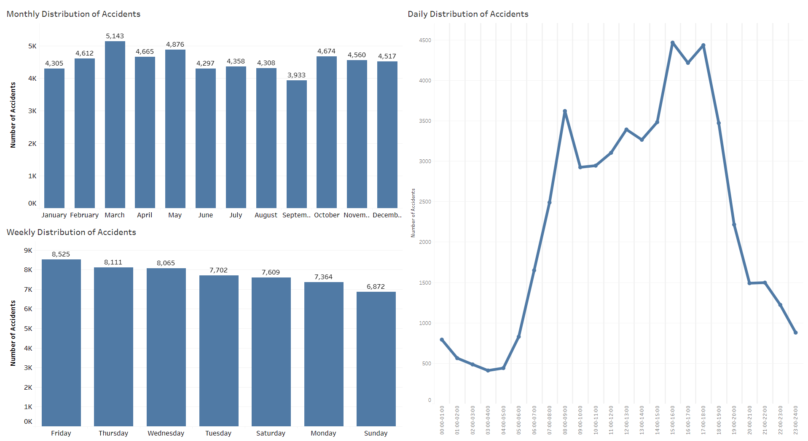
Peak time:
08:00-09:00, 14:00-19:00

Slide 6
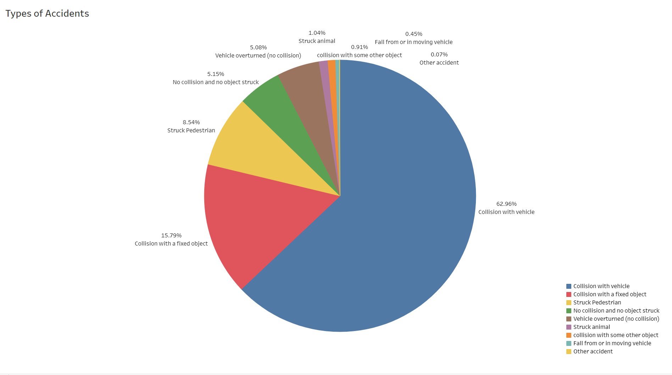
Common Accidents
“Collision with vehicle” is the most common accidents.

Slide 7
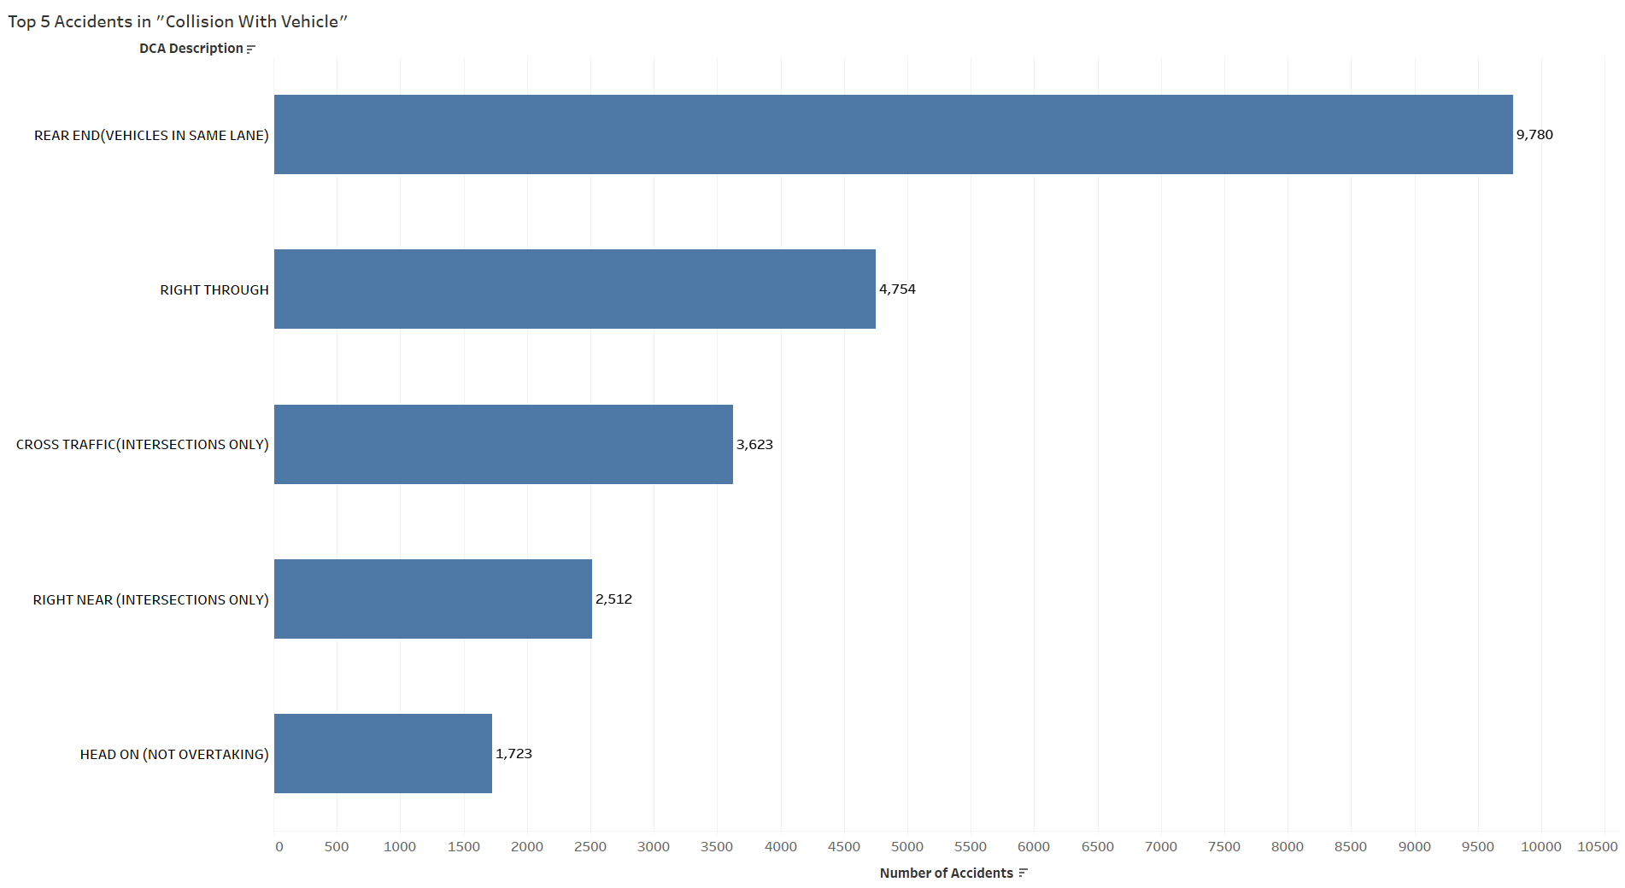
Definitions for Classifying Accidents (DCA)
In terms of “Collison with vehicle”, Rear end (Vehicles in same lane)” has the largest number of cases.

Slide 8
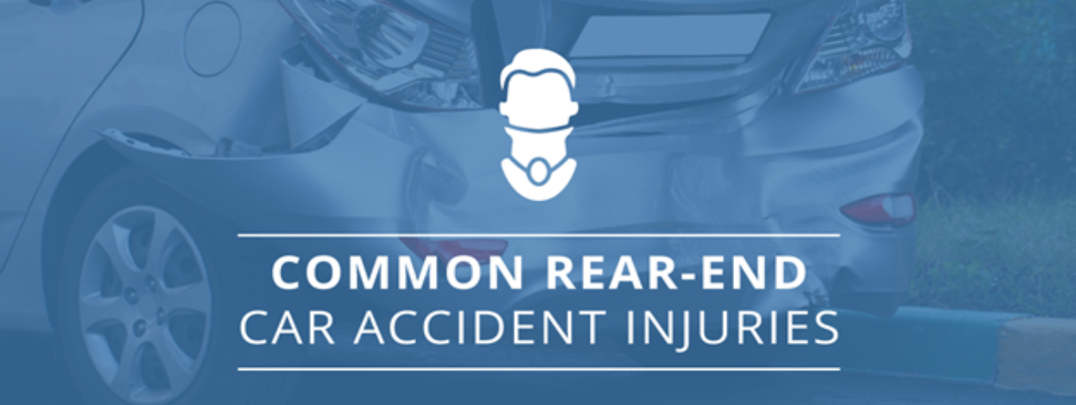
Rear End (vehicle in same lane) It occurs when a vehicle crashes into the one in front of it.
Common Factors
Driver distraction
Tailgating
Wet weather
Worn pavement
Ways to Improvements
Good education for drivers including focus on driving, keep enough safe distance, avoid panic stop, safe drive under bad weather, etc.
Necessary policy and punishment for distracted drivers.
Road maintenance.

Slide 9
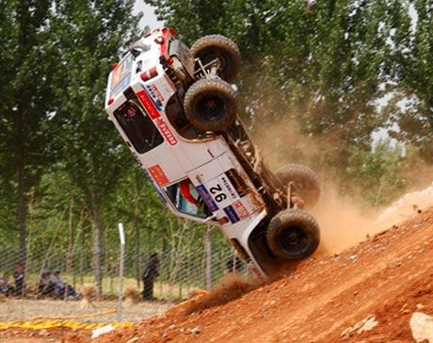
Serious and Fatal Accidents
16,310 serious and fatal accidents
17,877 persons seriously injured
1,031 persons killed

Slide 10
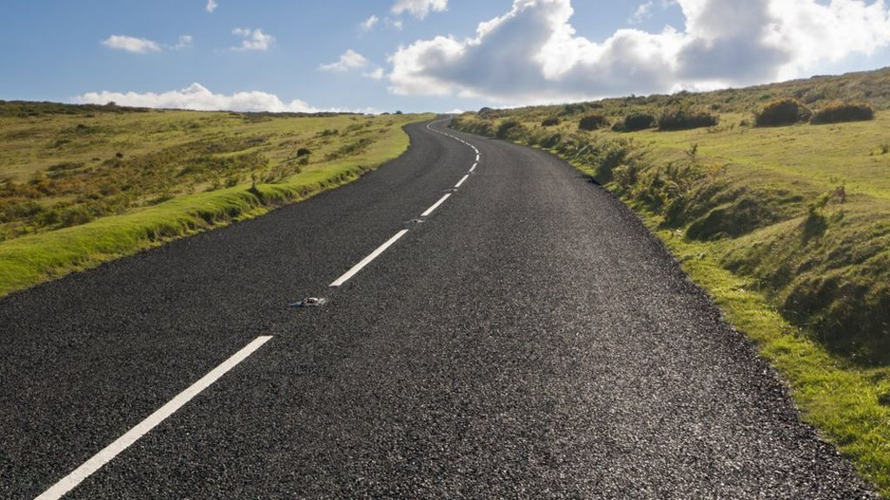
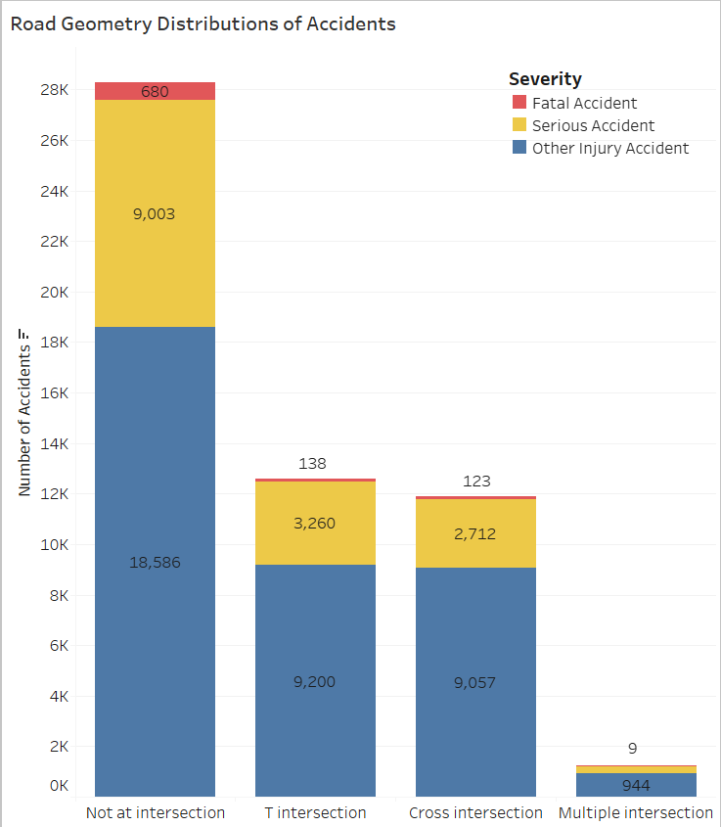
Road Geometry
Not at intersection
T intersection
Cross intersection
Multiple intersection
…

Slide 11
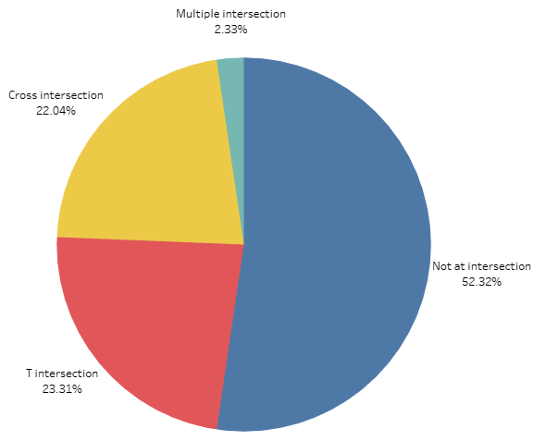
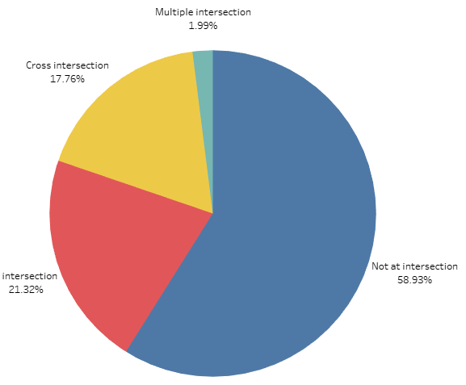
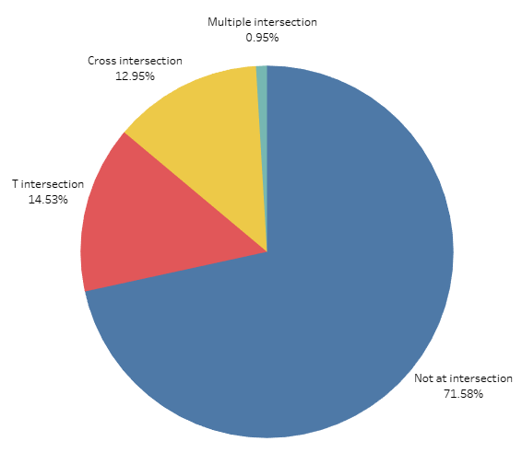
Different Severity Accidents for Road Geometry
Serious and fatal accidents are more likely to happen at no intersection roads.
All Accidents
Serious Injury Accidents
Fatal Accidents

Slide 12
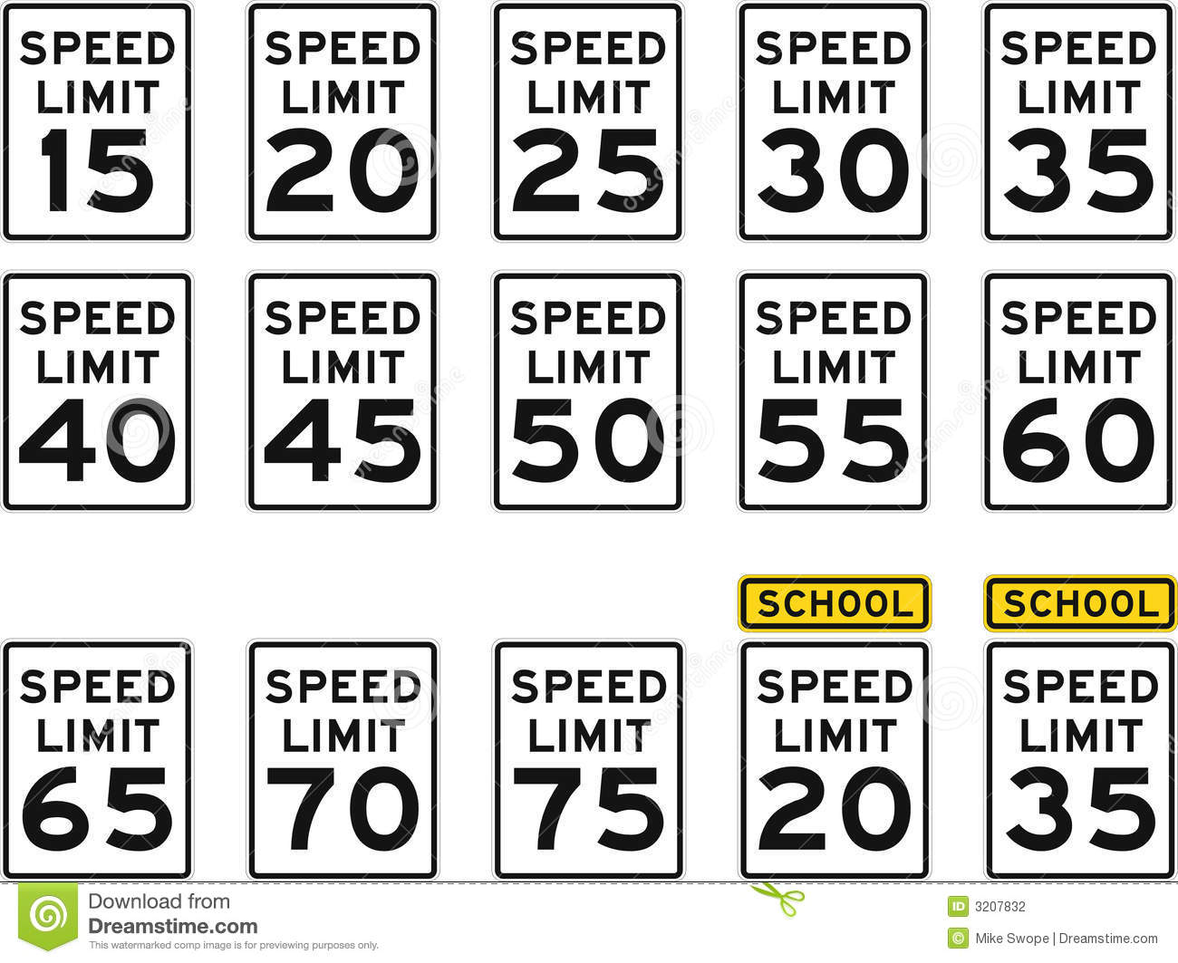
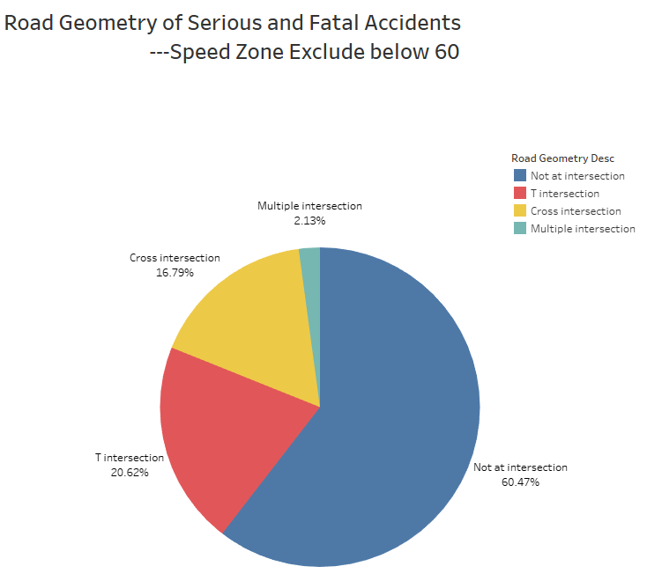
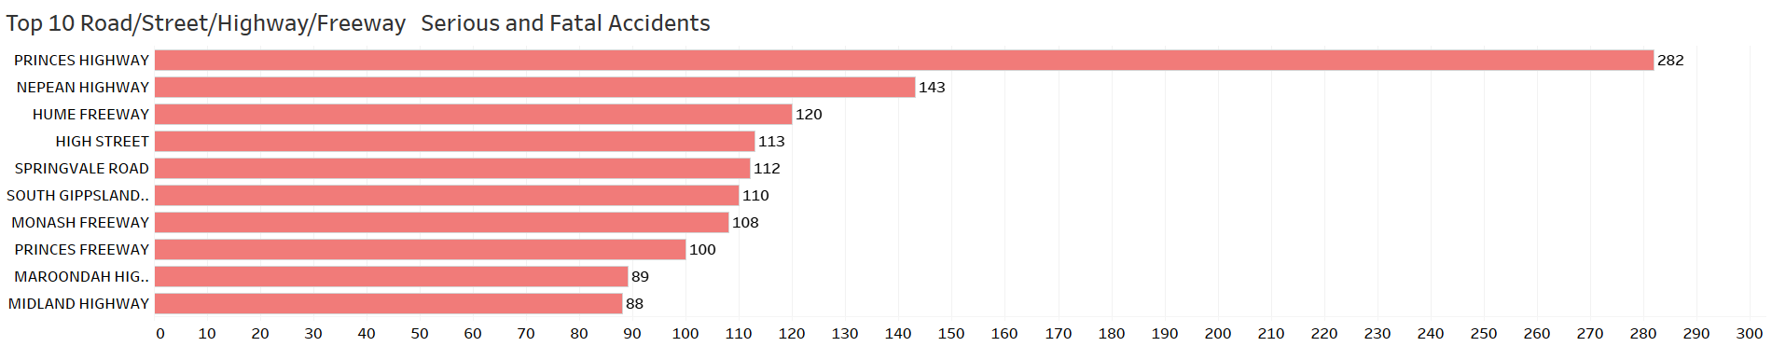
Speed Zone
Approximately 79% serious and fatal accidents happen in over 60 (included) speed zone, and 60.47% happen at no intersection road/street/freeway.

Slide 13
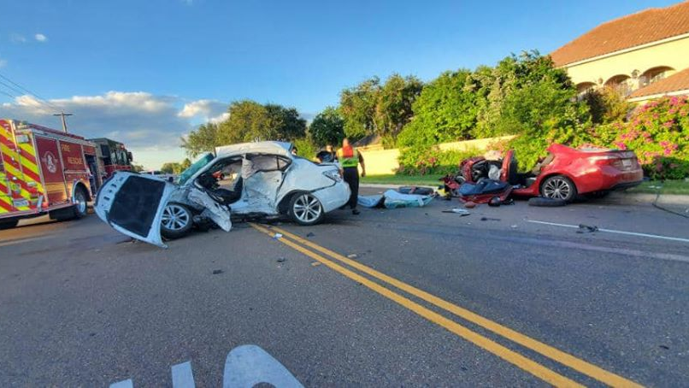
Serious and Fatal Accidents
Common Factors
Speeding
Reckless Driving
Sleepy Driving
Drunk Driving
Extreme Weather
Animal Crossing
…
Ways to Improvements
Good education for drivers including focus on safe driving, avoid unqualified driving, avoid extreme weather driving, and pay more attention on no intersection roads, etc.
Necessary or more strict policy and punishment for unqualified drivers, such as speeding and drunk drivers.
Lower speed limit of dangerous roads.
Warning sign for animal crossing.

Slide 14
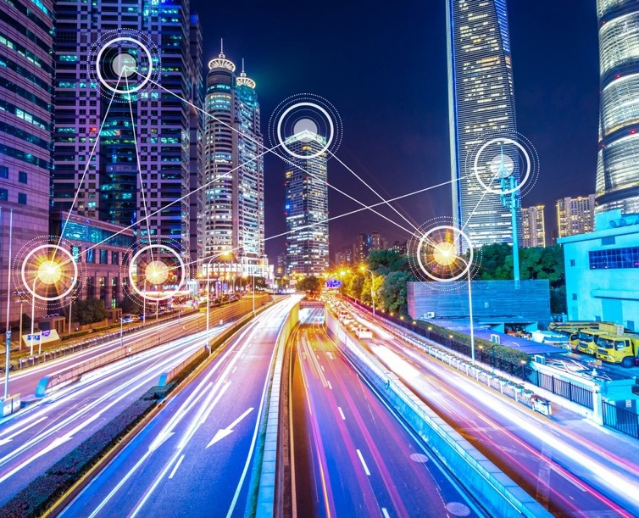
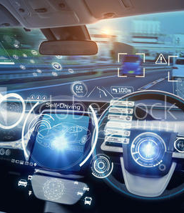
Other Recommendations for Accidents Control
Smart City Strategy
Solve traffic congestion
Monitoring and measurement
Driver and vehicle profiles control
…
Smart cars
Self-driving
Park assist
Automatic breaking
…

Slide 15
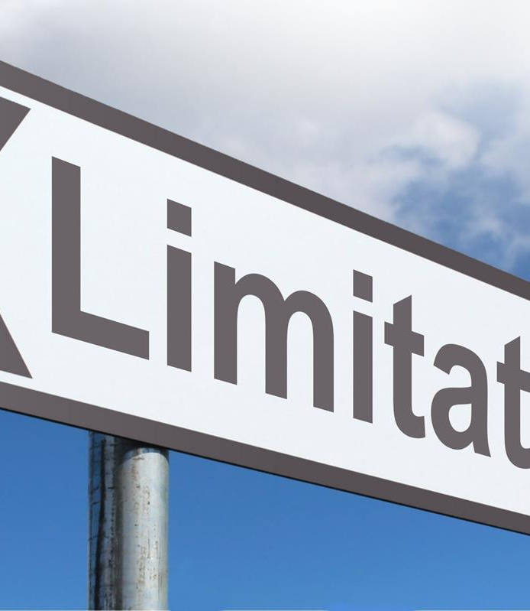
Limitations
Dataset
Driver data
Traffic flow data
Improvements
Comprehensive research
Traffic and accidents experts

Slide 16


